Slide 1
Virtual Memory Lesson 8 Others
David Liu
Fall 2021, Spring 2022

Slide 2
Other Considerations
Prepaging
Page size
TLB reach
Inverted page table
Program structure
I/O interlock and page locking

Slide 3
Prepaging
To reduce the large number of page faults that occurs at process startup
Pre-page all or some of the pages a process will need, before they are referenced
But if pre-paged pages are unused, I/O and memory was wasted
Assume s pages are pre-paged and α of the pages is used
Is cost of s * α save pages faults > or < than the cost of pre-paging s * (1- α) unnecessary pages?
α near zero ⇒ pre-paging loses

Slide 4
Page Size
Sometimes OS designers have a choice
Especially if running on custom-built CPU
Page size selection must take into consideration:
Fragmentation
Page table size
Resolution
I/O overhead
Number of page faults
Locality
TLB size and effectiveness
Always power of 2, usually in the range 2¹² (4,096 bytes) to 2²² (4,194,304 bytes)
On average, growing over time

Slide 5
TLB Reach
TLB Reach - The amount of memory accessible from the TLB
TLB Reach = (TLB Size) X (Page Size)
Ideally, the working set of each process is stored in the TLB
Otherwise there is a high degree of page faults
Increase the Page Size
This may lead to an increase in fragmentation as not all applications require a large page size
Provide Multiple Page Sizes
This allows applications that require larger page sizes the opportunity to use them without an increase in fragmentation

Slide 6
Program Structure
Program structure
int[128,128] data;
Each row is stored in one page
Program 1
for (j = 0; j <128; j++) for (i = 0; i < 128; i++) data[i,j] = 0;
128 x 128 = 16,384 page faults
Program 2
for (i = 0; i < 128; i++) for (j = 0; j < 128; j++) data[i,j] = 0;
128 page faults

Slide 7
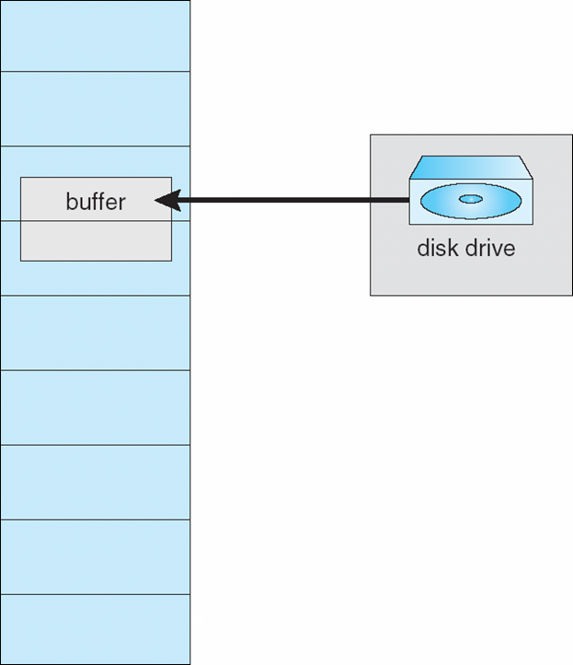
I/O interlock
I/O Interlock – Pages must sometimes be locked into memory
Consider I/O - Pages that are used for copying a file from a device must be locked from being selected for eviction by a page replacement algorithm
Pinning of pages to lock into memory

Slide 8
Operating System Examples
Windows
Solaris

Slide 9
Windows
Uses demand paging with clustering. Clustering brings in pages surrounding the faulting page
Processes are assigned working set minimum and working set maximum
Working set minimum is the minimum number of pages the process is guaranteed to have in memory
A process may be assigned as many pages up to its working set maximum
When the amount of free memory in the system falls below a threshold, automatic working set trimming is performed to restore the amount of free memory
Working set trimming removes pages from processes that have pages in excess of their working set minimum

Slide 10
Solaris
Maintains a list of free pages to assign faulting processes
Lotsfree – threshold parameter (amount of free memory) to begin paging
Desfree – threshold parameter to increasing paging
Minfree – threshold parameter to being swapping
Paging is performed by pageout process
Pageout scans pages using modified clock algorithm
Scanrate is the rate at which pages are scanned. This ranges from slowscan to fastscan
Pageout is called more frequently depending upon the amount of free memory available
Priority paging gives priority to process code pages

Slide 11
Solaris 2 Page Scanner

